Slide 1
Machine Learning for Lung Cancer Diagnosis, Treatment, and Prognosis
Paper Review
By Yawei Li et al, 2022

Slide 2
Table of Content
1
Contributing authors of review paper
Introduction
Machine Learning (ML) for early detection & diagnosis
ML for Prognosis & therapy response prediction
ML for Immunotherapy response prediction
Challenges & Future perspectives
Conclusions
References

Slide 3




Paper review contributors Track: data science & Machine learning
2
Chidimma Nwaku
Taofeeq Togunwa
Melvin Khakabo
Ifeoluwa Awoleke

Slide 4
Research context & relevance
3
Lung cancer is the leading cause of cancer deaths worldwide for both sexes & the most diagnosed.
It’s difficult to treat cancer because cancerous cells are very different and can mutate quickly, making it hard for treatments to work and leading to drug resistance
Over the years, technologies for cancer research have evolved leading to new cancer projects and subsequently is has generated large & different types of data
Analyzing this data & gaining insights poses a challenge to researchers & physicians because it requires time, efforts & expertise, even with dimension reduction methods like matrix & tensor factorization
This is where ML comes into play

Slide 5
4
What role do Machine learning(ML) approaches play in improving lung cancer diagnosis, treatment and prognosis, and what are the challenges and opportunities for future applications in this field?

Slide 6
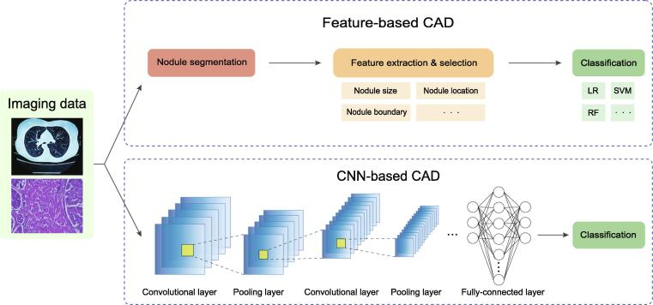
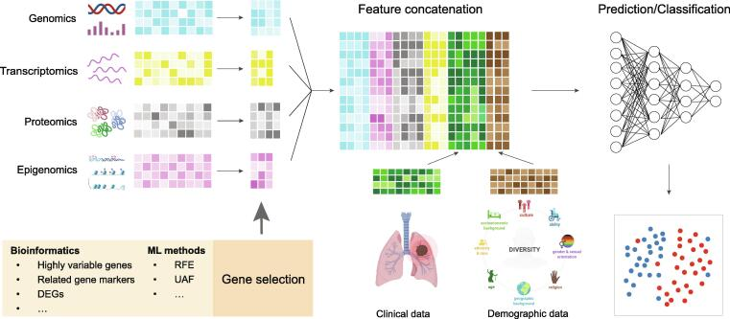
ML for early detection & diagnosis
Figure 1: Feature-based CAD and DL-based CAD systems
5
Using Medical imaging datasets
Using Omics sequencing datasets
Figure 2: Omics analysis in lung cancer studies

Slide 7
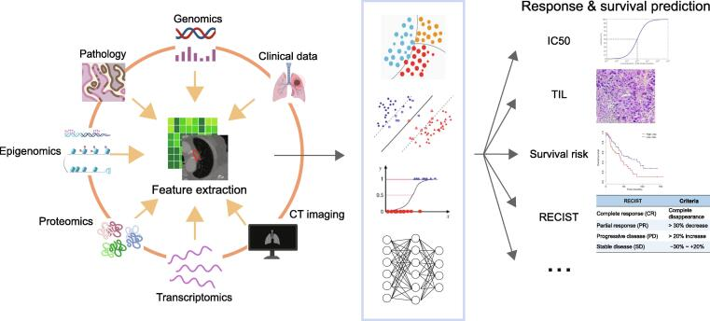
Prognosis & therapy response prediction
6
Treatment response
Survival prediction
Figure 3: Diagram of ML applications in treatment response and survival prediction

Slide 8
Immunotherapy response prediction
7
Tumor-infiltrating lymphocyte evaluation: The proportion of tumor-infiltrating lymphocytes (TILs) is another important metric for immunotherapy response evaluation.
Neoantigen prediction: ML algorithms have shed light on neoantigen prediction for immunotherapy. Neoantigens are tumor-specific mutated peptides generated by somatic mutations in tumor cells, which can induce antitumor immune responses

Slide 9
Challenges & Future perspectives
8
Imaging data analysis
Omics dataset analysis
Clinical decision making
In ML-based CAD system, feature extractions were typically based on the image intensity, shape, and texture of a suspicious region along with other clinical variables
While, DL-based CAD system was developed leveraging CNN models to extract features directly from raw imaging data with multilevel representations and hierarchical abstraction
Recently, the Vision Transformer (ViT) has emerged as the current state-of-the-art in computer vision
input dimension of the omics data is usually very high, to improve efficiency and reduce overfitting, many studies have used autoencoders or deep generative models for feature extraction and dimensionality reductio
Accurate prognosis prediction and decision-making will pave the way for personalized treatment.
However, most existing DL models for clinical decision-making have difficulty in keeping up with knowledge evolution and/or dynamic health care data change

Slide 10
Conclusion
9
The future of lung cancer treatment is data driven, and ML is leading the way. By harnessing the power of ML, we can create a brighter future for cancer patients

Slide 11
Reference
10
Li, Yawei, et al. “Machine Learning for Lung Cancer Diagnosis, Treatment, and Prognosis.” PubMed Central, vol. 20, no. 5, 2022, pp. 850-866. National Library of Medicine, https://www.ncbi.nlm.nih.gov/pmc/articles/PMC10025752/. Accessed 8 September 2024.

